Slide 1

Gathering Feedback to inform future development
Muhammed

Slide 2

Set Task Brief
"Your manager has asked you to gather feedback on your prototype that you can use in evaluating the effectiveness of the prototype in order to be able to identify and plan the next steps for future iteration."

Slide 3
Activities
Produce materials to support the gathering of as well as gain feedback for a technical and non-technical audience.
You need to:
use appropriate tools, methods and techniques to prepare demonstrations of the prototypes’ functionality that are intended to be used to show the functionality of the prototype to:
  a technical audience, (e.g. programming professionals)
  a non-technical audience, (e.g. the client, the users)
produce a plan for how you intend to gather feedback
use the materials you produce to gather feedback
record the feedback received in a format(s) suitable for analysis

Slide 4
Task 3a – Gathering Feedback to Inform Future Development
24 Marks
15 Hours

Slide 5
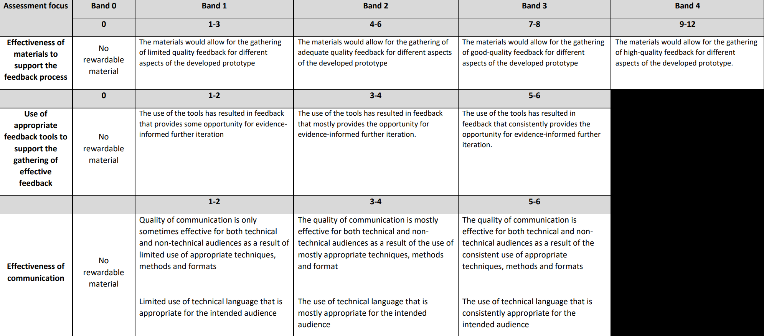

Slide 6
What do you need to do?
Create Methods for gathering feedback
  Surveys
  Questionnaires
  Observations
  Paired Coding Reviews

Slide 7
What do I suggest?
You need to make different feedback sheets for two different audiences
Technical Audience
  Paired Coding Review
Non-Technical Audience
  Questionnaire
  Observation (Scenario Based)

Slide 8
Paired Coding Reviews
Allow for other programmers to go through the code and then ask them questions about the quality of the code
  What can be improved
  What is good?
  What is bad?
  How organised is the code and the project?
  Think about technical questions about the efficiency of the code

Slide 9
Questionnaires
Think about questions you can ask users or clients for feedback about the usability of the web application
Ask about the design, the colours, the fonts, images, loading speed and more
Use Microsoft Forms or Google Forms

Slide 10
Observations (Scenario Based)
Think back to our paper protype reviews
Create scenarios for the user to follow
  Login
  Register a new account
  Find Health Advice for Birmingham
  Base these on your functional requirements and try to be detailed
You will then have a form that you fill out saying if they were able to complete the task, how long it took and any issues or comments they had

Slide 11
Holiday Work
Start preparing these
When you come back, in the exam you will not only have to make these but collect the feedback with the other members of the group
Use Microsoft and Google Forms , because you can then reference these graphs

